Slide 1
APPLIED COST-EFFECTIVENESS MODELING WITH R

Slide 2
Learning objectives
Understand how R can be used to perform model-based cost-effectiveness analysis with existing packages;
Develop own models in R by modifying existing code for commonly used model types;
Understand how using R can improve reproducibility and transparency of model-based cost-effectiveness analysis

Slide 3
Agenda
Introduction
Basic model taxonomy
Simple Markov cohort model
Semi-Markov multi-state model
Partitioned survival model
Cost-effectiveness analysis
Summary

Slide 4
Structure
Presentation
Exercises using R

Slide 5
Introduction

Slide 6
Criteria that economic models should strive to meet
Clinical realism
A model should reflect the state of evidence, the current understanding of the disease, and be accepted by clinical experts.
Quantifying decision uncertainty
A model should be capable of quantifying decision uncertainty and informing prioritization of future research.
Transparency and reproducibility
Resources should exist so that a model can be completely understood, reproduced, and pressure tested.
Reusability and adaptability
It should be possible to easily update a model to reflect new clinical evidence or adapt it for a new market, indication, or intervention.
Notes:
Historically, models have been developed with specialized commercial software (such as TreeAge) or more commonly with spreadsheet software (almost always Microsoft Excel). Although these tools may be sufficient for relatively simple analyses, methodological and computational advances now allow for models that are increasingly sophisticated and realistic but cannot be reasonably computed in Excel. Related fields such as statistics, economics, and machine learning utilize many of these advances and consequently make heavy use of modern programming languages such as R, Python, MATLAB, and Julia.¹⁻⁴ Yet, in the context of HTA, there seems to be an ongoing preference among manufactures preparing submissions and reviewers for economic models in Excel.

Slide 7
Structural uncertainty
Notes:
How can we capture multiple model structures with excel

Slide 8

Plugging in model input parameter estimates

Slide 9
Transparency & reproducibility

Slide 10
What do we mean with model transparency?
Concept, math
Face validity
Implementation/programming
Open-source, open-access
Familiarity with software?

Slide 11
Modeling in Excel
Excel has been dominant software platform used by modelers forever, especially for HTA submissions
Reasons are not surprising
(practically) Everyone with a computer has access to Excel
Does not require that you learn a new programming language
Many users consider its “transparency” to be an attribute
With models in Excel, you can follow calculations that are being performed in every single cell of every single worksheet

Slide 12
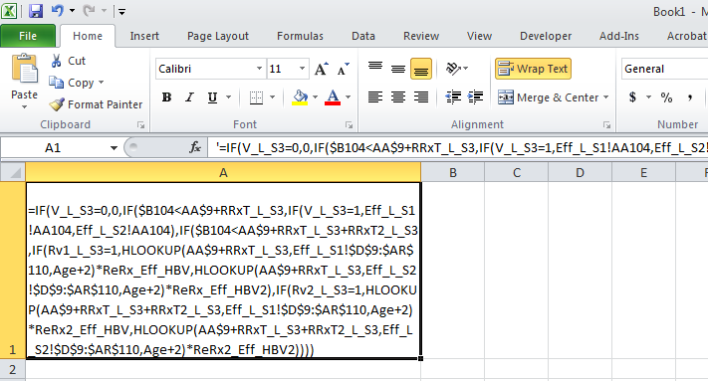
Modeling in Excel
Virtually all textbooks use it
And for simple models, it is transparent and fast to build
However……
Transparent???

Slide 13
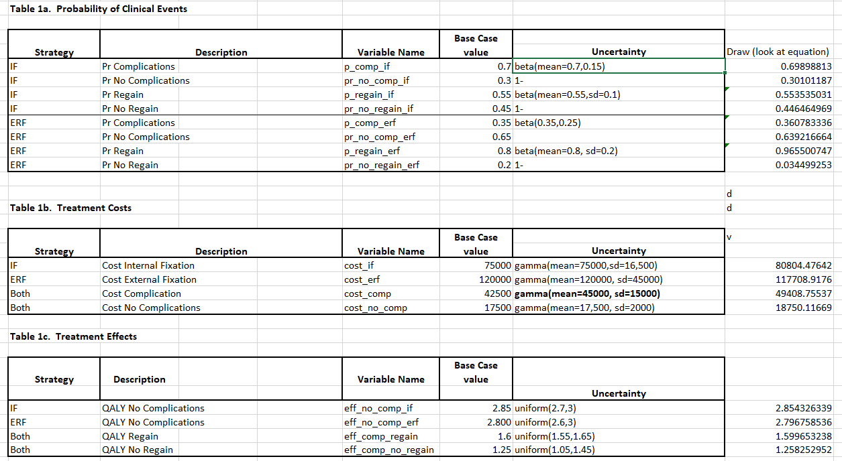

Slide 14
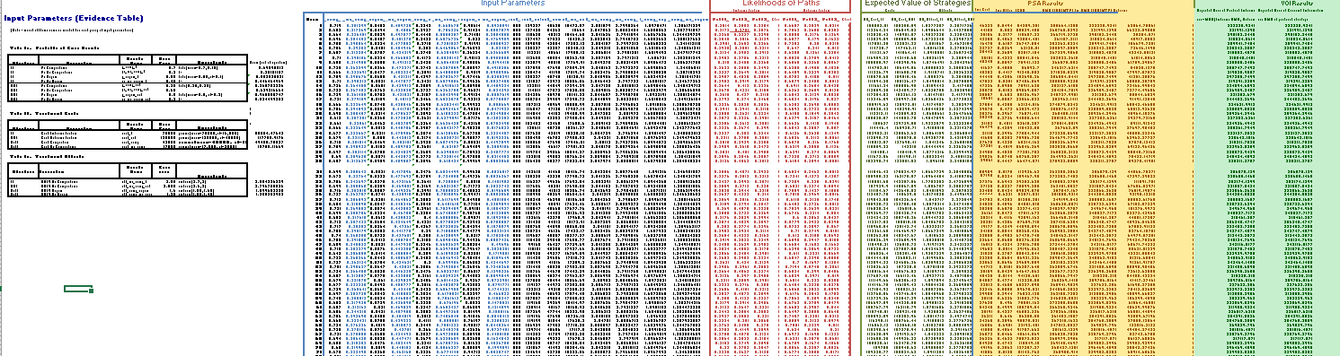

Slide 15
Where is Waldo

Slide 16
Criticisms
Really hard to check, models can be validated by building second one from scratch, this is rarely done due to budget and time constraints
Complex procedures generally require VBA knowledge
Increasingly more data and other models, inform CEA. Excel cannot do all of these things
Slow performance with large and complex models

Slide 17

Time to change?

Slide 18
Alternative
BCEA HEEMOD HESIM …

Slide 19
What is R
Statistical programing language and environment for statistical computing
Totally free to use (open source, user developed packages that are completely transparent)
Very good for regression analysis, hypothesis testing, data management, visualization and cleaning (and many, many other things)
All parts of an analysis can exist in one file (code)
CEA models can be coded from ‘scratch’ using r core or via convenient and improving packages

Slide 20
Programing in R
Everything is an object or function
Code can be highly customized or generalized to suit purposes
Packages are shareable bundles of code, data, and documentation that allow for reproducible analysis
Built for statistical analysis, contains may functions relevant for CEA
There are many ways to do the same thing

Slide 21
Basic model taxonomy

Slide 22
Health states describing course of disease over time

Slide 23



Markov model
Clock forward
$$h_{}^{SD}\left(u\right)$$
$$h_{}^{SP}\left(u\right)$$
$$h_{}^{PD}\left(u\right)$$
transition rates depend only on time in model

Slide 24



Semi-Markov model
Clock reset
$$h_{}^{SD}\left(u\right)$$
$$h_{}^{SP}\left(u\right)$$
$$h_{}^{PD}\left(u,u_{P}\right)$$
transition rates depend on time in model
some transitions depend on time in an intermediate health state

Slide 25
Partitioned survival model
Source: Woods B, Sideris E, Palmer S, Latimer N, Soares M. NICE DSU Technical Support Document 19. Partitioned Survival Analysis for Decision Modelling in Health Care: A Critical Review. 2017 [Available from http://www.nicedsu.org.uk]

Slide 26
Simple Markov cohort model

Slide 27
Model

Slide 28
Model
 | Healthy | Sick | Sicker | Death
Healthy | 0.848 | 0.15 | 0 | 0.002
Sick | 0.5 | 0.395 | 0.105 | 0.006
Sicker | 0 | 0 | 0.98 | 0.02
Death | 0 | 0 | 0 | 1.000
Annual transition probabilities with monotherapy
Relative risk of disease progression with combination therapy 0.8
Drug costs
Other annual costs and utility
Annual discount rates of 3% for costs and 3% for QALYs
 | New | SOC
Drug costs | 12000 | 2000
 | Healthy | Sick | Sicker | Death
Direct medical | 2000 | 4000 | 15000 | 0
Utility | 1 | 0.75 | 0.5 | 0

Slide 29
Steps
Define transition matrix SOC
Define transition matrix New treatment
Define utility and cost values by health state
Calculate health state probabilities over time
Calculate expected QALYs and costs
Cost-effectiveness analysis

Slide 30
Define transition matrix with standard of care
p_hd <- 0.002 # constant probability of dying when Healthy (all-cause mortality)
p_hs1 <- 0.15 # probability of becoming Sick when Healthy
p_s1h <- 0.5 # probability of becoming Healthy when Sick
p_s1s2 <- 0.105 # probability of becoming Sicker when Sick
p_s1d <- 0.006 # constant probability of dying when Sick
p_s2d <- 0.02 # constant probability of dying when Sicker
p_hh <- 1 - p_hs1 - p_hd
p_s1s1 <- 1 - p_s1h - p_s1s2
p_s2s2 <- 1 - p_s2d
p_soc <- matrix(
c(p_hh, p_hs1, 0, p_hd,
p_s1h, p_s1s1, p_s1s2, p_s1d,
0, 0, p_s2s2, p_s2d,
0, 0, 0, 1),
byrow = TRUE,
nrow = 4, ncol = 4
)
state_names <- c("H", "S1", "S2", "D")
colnames(p_soc) <- rownames(p_soc) <- state_names
print(p_soc)
H S1 S2 D
H 0.848 0.150 0.000 0.002
S1 0.500 0.395 0.105 0.006
S2 0.000 0.000 0.980 0.020
D 0.000 0.000 0.000 1.000

Slide 31
Relative risk and transition matrix with New treatment
apply_rr <- function(p, rr = .8){
p["H", "S1"] <- p["H", "S1"] * rr
p["H", "S2"] <- p["H", "S2"] * rr
p["H", "D"] <- p["H", "S2"] * rr
p["H", "H"] <- 1 - sum(p["H", -1])
p["S1", "S2"] <- p["S1", "S2"] * rr
p["S1", "D"] <- p["S1", "D"] * rr
p["S1", "S1"] <- 1 - sum(p["S1", -2])
p["S2", "D"] <- p["S2", "D"] * rr
p["S2", "S2"] <- 1 - sum(p["S2", -3])
return(p)
}
p_new <- apply_rr(p_soc, rr = .8)
H S1 S2 D
H 0.88 0.1200 0.000 0.0000
S1 0.50 0.4112 0.084 0.0048
S2 0.00 0.0000 0.984 0.0160
D 0.00 0.0000 0.000 1.0000

Slide 32
Utility and costs
utility <- c(1, .075, 0.5, 0)
costs_medical <- c(2000, 4000, 15000, 0)
costs_treat_soc <- c(rep(2000, 3), 0)
costs_treat_new <- c(rep(12000, 3), 0)
> utility
[1] 1.000 0.075 0.500 0.000
> costs_medical
[1] 2000 4000 15000 0
> costs_treat_soc
[1] 2000 2000 2000 0
> costs_treat_new
[1] 12000 12000 12000 0

Slide 33
Simulation – health state probabilities
x_init <- c(1, 0, 0, 0)
x_init %*% p_soc
H S1 S2 D
[1,] 0.848 0.15 0 0.002
x_init %*% p_soc %*% p_soc
H S1 S2 D
[1,] 0.794104 0.18645 0.01575 0.004596

Slide 34
Simulation – health state probabilities with a function
sim_markov_chain <- function(x0, p, n_cycles = 85){
x <- matrix(NA, ncol = length(x0), nrow = n_cycles) # Initialize Markov trace
x <- rbind(x0, x) # Markov trace at cycle 0 is initial state vector
colnames(x) <- colnames(p) # Columns are the health states
rownames(x) <- 0:n_cycles # Rows are the model cycles
for (t in 1:n_cycles){ # Simulating state vectors at each cycle with for loop
x[t + 1, ] <- x[t, ] %*% p
}
return(x)
}

Slide 35
Simulation – health state probabilities with a function
x_soc <- sim_markov_chain(x_init, p_soc)
x_new <- sim_markov_chain(x_init, p_new)
H S1 S2 D
0 1.0000000 0.00000000 0.00000000 0.000000000
1 0.8480000 0.15000000 0.00000000 0.002000000
2 0.7941040 0.18645000 0.01575000 0.004596000
3 0.7666252 0.19276335 0.03501225 0.007617908
4 0.7464798 0.19113530 0.05455216 0.011007983
5 0.7285826 0.18747042 0.07353032 0.014738798
6 0.7115732 0.18333820 0.09174411 0.018791392
7 0.6950832 0.17915457 0.10915974 0.023149450
8 0.6790078 0.17502853 0.12578777 0.027797738
9 0.6633129 0.17098744 0.14165001 0.032721681
---
79 0.1290990 0.03327921 0.31441990 0.567627648
80 0.1261155 0.03251013 0.31162581 0.574373920
81 0.1232010 0.03175883 0.30880686 0.581053728
82 0.1203539 0.03102489 0.30596540 0.587666820
83 0.1175726 0.03030792 0.30310371 0.594212985
84 0.1148555 0.02960751 0.30022397 0.600692052
85 0.1122012 0.02892329 0.29732827 0.607103887
H S1 S2 D
0 1.0000000 0.00000000 0.00000000 0.000000000
1 0.8800000 0.12000000 0.00000000 0.000000000
2 0.8344000 0.15494400 0.01008000 0.000576000
3 0.8117440 0.16384097 0.02293402 0.001481011
4 0.7962552 0.16478069 0.03632971 0.002634392
5 0.7830949 0.16330844 0.04959002 0.004006615
6 0.7707778 0.16112382 0.06251448 0.005583936
7 0.7588463 0.15874745 0.07504865 0.007357562
8 0.7471585 0.15633851 0.08718266 0.009320328
9 0.7356687 0.15394542 0.09892017 0.011465675
---
79 0.2488207 0.05206970 0.33613574 0.362973847
80 0.2449971 0.05126955 0.33513142 0.368601954
81 0.2412322 0.05048169 0.33407596 0.374210150
82 0.2375252 0.04970593 0.33297121 0.379797678
83 0.2338751 0.04894210 0.33181896 0.385363805
84 0.2302812 0.04819001 0.33062100 0.390907831
85 0.2267424 0.04744947 0.32937902 0.396429079

Slide 36
Computing a present value with a function
pv <- function(z, dr, t) {
z/(1 + dr)^t
}

Slide 37
QALYs after 1st cycle
x_soc[2, ] # State occupancy probabilities after 1st cycle
H S1 S2 D
0.848 0.150 0.000 0.002
sum(x_soc[2, 1:3]) # Expected life-years after 1st cycle
[1] 0.998
sum(x_soc[2, ] * utility) # Expected utility after 1st cycle
[1] 0.9605
sum(pv(x_soc[2, ] * utility, .03, 1)) # Expected discounted utility after 1st cycle
[1] 0.9325

Slide 38
Discounted QALYs for each cycle
compute_qalys <- function(x, utility, dr = .03){
n_cycles <- nrow(x) - 1
pv(x %*% utility, dr, 0:n_cycles)
}
dqalys_soc <- compute_qalys(x_soc, utility = utility)
dqalys_new <- compute_qalys(x_new, utility = utility)
head(dqalys_soc)
head(dqalys_new)
[,1]
0 1.0000000
1 0.9325243
2 0.8877524
3 0.8498956
4 0.8148380
5 0.7814809
[,1]
0 1.0000000
1 0.9417476
2 0.9007899
3 0.8658080
4 0.8334058
5 0.8025464

Slide 39
Discounted cost for each cycle
compute_costs <- function(x, costs_medical, costs_treat, dr = .03){
n_cycles <- nrow(x) - 1
costs <- cbind( pv(x %*% costs_medical, dr, 0:n_cycles),
pv(x %*% costs_treat, dr, 0:n_cycles)
)
colnames(costs) <- c("medical", "treatment")
return(costs)
}
dcosts_soc <- compute_costs(x_soc, costs_medical, costs_treat_soc)
dcosts_new <- compute_costs(x_new, costs_medical, costs_treat_new)
head(dcosts_soc)
head(dcosts_new)
medical treatment
0 2000.000 2000.000
1 2229.126 1937.864
2 2422.715 1878.224
3 2589.382 1820.035
4 2732.794 1763.056
5 2855.236 1707.246
medical treatment
0 2000.000 12000.00
1 2174.757 11650.49
2 2299.723 11304.64
3 2400.290 10965.44
4 2484.724 10633.76
5 2556.146 10309.83

Slide 40
Cost-effectiveness
(sum(dcosts_new) - sum(dcosts_soc))/(sum(dqalys_new) - sum(dqalys_soc))
[1] 115106.8
format_costs <- function(x) formatC(x, format = "d", big.mark = ",")
format_qalys <- function(x) formatC(x, format = "f", digits = 2)
make_icer_tbl <- function(costs0, costs1, qalys0, qalys1){
# Computations
total_costs0 <- sum(costs0)
total_costs1 <- sum(costs1)
total_qalys0 <- sum(qalys0)
total_qalys1 <- sum(qalys1)
incr_total_costs <- total_costs1 - total_costs0
inc_total_qalys <- total_qalys1 - total_qalys0
icer <- incr_total_costs/inc_total_qalys
# Make table
tibble(
`Costs` = c(total_costs0, total_costs1) %>%
format_costs(),
`QALYs` = c(total_qalys0, total_qalys1) %>%
format_qalys(),
`Inremental costs` = c("--", incr_total_costs %>% format_costs()),
`Inremental QALYs` = c("--", inc_total_qalys %>% format_qalys()),
`ICER` = c("--", icer %>% format_costs())
) %>%
kable() %>%
kable_styling() %>%
footnote(general = "Costs and QALYs are discounted at 3% per annum.", footnote_as_chunk = TRUE)
}

Slide 41
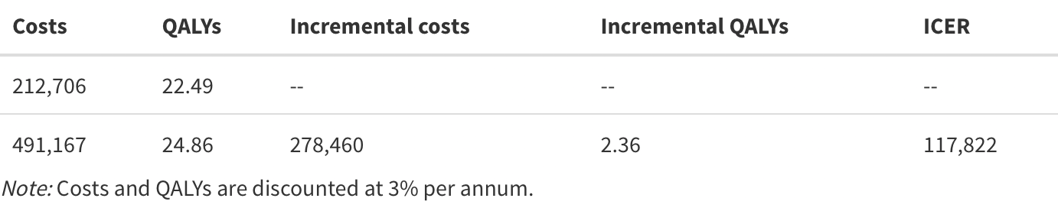
Cost-effectiveness
make_icer_tbl(costs0 = dcosts_soc, costs1 = dcosts_new,
qalys0 = dqalys_soc, qalys1 = dqalys_new)

Slide 42
Steps
Define transition matrix SOC
Define transition matrix New treatment apply_rr(p_soc, rr)
Define utility and cost values by health state
Calculate health state probabilities over time sim_markov_chain(x0, p, n_cycles)
Calculate expected QALYs and costs
pv(z, dr, t)
compute_qalys(x, utility, dr)
compute_costs(x, utility, dr)
Cost-effectiveness analysis make_icer_tbl(costs0, costs1, qalys0, qalys1)

Slide 43
Complete R script
Link to complete R script

Slide 44
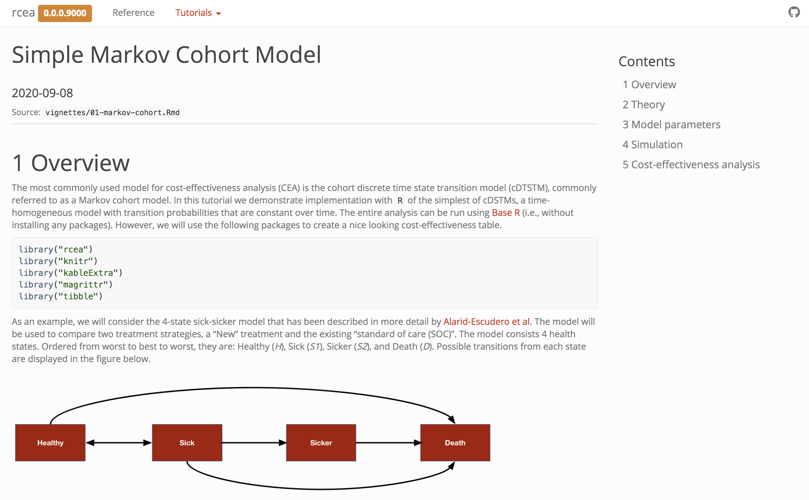
Online documentation
https://hesim-dev.github.io/rcea/articles/01-markov-cohort.html

Slide 45
Exercise 1: Simple Markov Cohort model
Review the “Simple Markov Cohort Model” documentation
Modify R-script “simple-markov-cohort-model”
Change relative risk
Change drug costs
Change utilities
Change follow-up time
Run modified script

Slide 46
Simple Markov cohort model – Incorporating probabilistic sensitivity analysis

Slide 47
Probabilistic sensitivity analysis
The standard methodology for quantifying the impact of parameter uncertainty is probabilistic sensitivity analysis (PSA)
Propagating uncertainty in the input parameters throughout the model by randomly sampling sets of input values from suitable probability distributions
Probability distributions are determined according to the distributional properties of the statistical estimates, which, in turn, depend on the statistical techniques used and the distributions of the underlying data
R is a natural programming language for performing PSA
Random samples can be drawn from almost any probability distribution

Slide 48
Transition probabilities for SOC
We assume that summary level data is available on transitions from the Healthy state (n = 900), Sick state (n = 900), and Sicker state (n = 800). The transitions from each state to the other 4 states can be modeled using a Dirichlet distribution
transitions_soc <- matrix(
c(848, 150, 0, 2,
450, 355, 95, 5,
0, 0, 784, 16,
0, 0, 0, 23),
nrow = 4, byrow = TRUE)
state_names <- c("H", "S1", "S2", "D")
colnames(transitions_soc) <- rownames(transitions_soc) <- tolower(state_names)
h s1 s2 d
h 848 150 0 2
s1 450 355 95 5
s2 0 0 784 16
d 0 0 0 23

Slide 49
Combining all model parameters
params <- list(
alpha_soc = transitions_soc,
lrr_mean = log(.8),
lrr_lower = log(.71),
lrr_upper = log(.9),
c_medical = c(H = 2000, S1 = 4000, S2 = 15000, D = 0),
c_soc = 2000,
c_new = 12000,
u_mean = c(H = 1, S1 = .075, S2 = 0.5, D = 0),
u_se = c(H = 0, S1 = 0.03, S2 = 0.05, D = 0.0)
)

Slide 50
Simulation
The simulation proceeds by
randomly sampling the parameters from the probability distributions specified
running the Markov model for each draw of the parameters
The result is a draw from the probability distribution of each of the model outputs of interest (i.e, state probabilities, QALYs, and costs).

Slide 51
Sampling parameters
While Base R can be used to draw samples of parameters, the functions hesim::define_rng() and hesim::eval_rng() simplify this process.
Any random number generation function can be used inside the define_rng() block
rng_def <- define_rng({
lrr_se <- (lrr_upper - lrr_lower)/(2 * qnorm(.975))
list( # Parameters to return
p_soc = dirichlet_rng(alpha_soc),
rr_new = lognormal_rng(lrr_mean, lrr_se),
c_medical = gamma_rng(mean = c_medical, sd = c_medical),
c_soc = c_soc,
c_new = c_new,
u = beta_rng(mean = u_mean, sd = u_se)
)
}, n = 1000)
params_rng <- eval_rng(rng_def, params = params)
attr(params_rng, "n") <- rng_def$n

Slide 52
Sampling parameters
names(params_rng)
[1] "p_soc" "rr_new" "c_medical" "c_soc" "c_new" "u"
head(as.matrix(params_rng$p_soc))
h_h h_s1 h_s2 h_d s1_h s1_s1 s1_s2 s1_d s2_h
[1,] 0.8648675 0.1344587 0 0.0006738016 0.4893881 0.4028700 0.10138215 0.006359690 0
[2,] 0.8644084 0.1341584 0 0.0014332112 0.5027019 0.4028378 0.08740946 0.007050816 0
[3,] 0.8518388 0.1462222 0 0.0019390579 0.4660475 0.4056999 0.12015422 0.008098349 0
[4,] 0.8324259 0.1667732 0 0.0008008371 0.4827817 0.4155604 0.09767953 0.003978354 0
[5,] 0.8352081 0.1639068 0 0.0008851192 0.4756373 0.4211925 0.09949040 0.003679711 0
[6,] 0.8458863 0.1509600 0 0.0031536920 0.5172189 0.3884067 0.09223853 0.002135855 0
s2_s1 s2_s2 s2_d d_h d_s1 d_s2 d_d
[1,] 0 0.9785385 0.02146148 0 0 0 1
[2,] 0 0.9772806 0.02271942 0 0 0 1
[3,] 0 0.9879967 0.01200326 0 0 0 1
[4,] 0 0.9853717 0.01462833 0 0 0 1
[5,] 0 0.9829372 0.01706285 0 0 0 1
[6,] 0 0.9866257 0.01337426 0 0 0 1

Slide 53
Simulating the Markov model
One way that a Markov simulation can be generalized is to store “input data” in an object, i.e. data frame.
Input data might consist of
treatment strategies
patients and subgroups
health states
For instance, if we were simulating different subgroups we might store the age and sex associated with the subgroup which could, in turn, be used as covariates in a statistical model.
data <- data.frame(
strategy = c("New", "SOC")
)
head(data)
strategy
1 New
2 SOC

Slide 54
Simulating the Markov model – Create the function
Set up a sim_model() function that runs the entire simulation.
Comprised of three smaller functions: sim_stateprobs(), compute_qalys(), and compute_costs().

Slide 55
Simulating the Markov model – Create the function
sim_stateprobs <- function(p0, rr, strategy, n_cycles){
rr <- ifelse(strategy == "New", rr, 1)
p <- tpmatrix(
C, p0$h_s1 * rr, p0$h_s2 * rr, p0$h_d * rr,
p0$s1_h, C, p0$s1_s2 * rr, p0$s1_d * rr,
p0$s2_h, p0$s2_s1, C, p0$s2_d * rr,
0, 0, 0, 1
)
x <- sim_markov_chain(x0 = c(1, 0, 0, 0),
p = matrix(as.matrix(p), ncol = 4, byrow = TRUE),
n_cycles = n_cycles)
return(x)
}
hesim::tpmatrix() makes it easy to define a transition probability matrix.
C denotes that a given element is the complement of all other elements in that row, ensuring that the probabilities sum to 1.

Slide 56
Simulating the Markov model – Create the function
# QALYs
compute_qalys <- function(x, utility, dr = .03){
n_cycles <- nrow(x) - 1
pv(x %*% utility, dr, 0:n_cycles)
}
# Costs
compute_costs <- function(x, costs_medical, costs_treat, dr = .03){
n_cycles <- nrow(x) - 1
costs_treat <- c(rep(costs_treat, 3), 0)
costs <- cbind(
pv(x %*% costs_medical, dr, 0:n_cycles),
pv(x %*% costs_treat, dr, 0:n_cycles)
)
colnames(costs) <- c("dcost_med", "dcost_treat")
return(costs)
}

Slide 57
Simulating the Markov model
sim_model <- function(params_rng, data, n_cycles = 85, dr_qalys = .03, dr_costs = .03){
# Initialize array of matrices
n_samples <- attr(params_rng, "n")
n_strategies <- nrow(data)
out <- array(NA, dim = c(n_cycles + 1, 7, n_samples * n_strategies))
dimnames(out) <- list(NULL, c("H", "S1", "S2", "D", "dqalys", "dcosts_med", "dcosts_treat"), NULL)
# Run the simulation
i <- 1
for (s in 1:n_samples){ # Start PSA loop
for (k in 1:n_strategies) { # Start treatment strategy loop
x <- sim_stateprobs(p0 = params_rng$p_soc[s, ],
rr = params_rng$rr_new[s],
strategy = data$strategy[k],
n_cycles = n_cycles)
dqalys <- compute_qalys(x, utility = unlist(params_rng$u[s]),dr = dr_qalys)
dcosts <- compute_costs(x,
costs_medical = unlist(params_rng$c_medical[s]),
costs_treat = ifelse(data$strategy[k] == "SOC",
params_rng$c_soc,
params_rng$c_new), dr = dr_costs)
out[, , i] <- cbind(x, dqalys, dcosts)
i <- i + 1
} # End treatment strategy loop
} # End PSA loop
# Store metadata and return
attr(out, "n_samples") <- n_samples
attr(out, "strategies") <- data$strategy
return(out)
}
PSA. samples; tx strategy; no. cycles; discount rates
An array to store the output.
A series of matrices each with n_cycles rows and columns for each output.
There is one matrix for each parameter sample for the PSA and treatment strategy.
Simulates
state probabilities (with sim_stateprobs()),
QALYs (with compute_qalys())
costs (with compute_costs())
for each parameter sample and treatment strategy.
The number of parameter samples and the names of the treatment strategies are saved as attributes (i.e., metadata) to the array which will be used to convert the array to a data frame.

Slide 58
Simulating the Markov model
sim_out <- sim_model(params_rng, data = data)
head(sim_out[, , 1])
H S1 S2 D dqalys dcosts_med dcosts_treat
[1,] 1.0000000 0.0000000 0.00000000 0.000000000 1.0000000 2734.207 12000.00
[2,] 0.8648891 0.1333145 0.00000000 0.001796392 0.9382590 2491.018 11629.56
[3,] 0.8133504 0.1712361 0.01149140 0.003922112 0.8938291 2364.921 11266.79
[4,] 0.7873548 0.1802757 0.02597836 0.006391158 0.8555178 2274.555 10911.51
[5,] 0.7693004 0.1806028 0.04090010 0.009196702 0.8199929 2195.976 10563.79
[6,] 0.7538456 0.1783331 0.05549530 0.012325960 0.7862375 2122.139 10223.72

Slide 59
Reorganize output
Although arrays are computationally efficient objects for storing data, they are not the most useful for summarizing data.
We will write to short functions to convert a 3D array to a data.table so that we can summarize outcomes for each parameter sample and treatment strategy very quickly

Slide 60
Reorganize output
# rbind an array of matrices into a single matrix
rbind_array <- function(x){
n_rows <- dim(x)[3] * dim(x)[1]
x_mat <- matrix(c(aperm(x, perm = c(2, 1, 3))),
nrow = n_rows, byrow = TRUE)
colnames(x_mat) <- dimnames(x)[[2]]
return(x_mat)
}
# Convert the array into a long dataframe with ID columns
array_to_dt <- function(x){
id_df <- expand.grid(cycle = 0:(dim(x)[1] - 1),
strategy = attr(x, "strategies"),
sample = 1:attr(x, "n_samples"))
x_mat <- rbind_array(x)
return(as.data.table(cbind(id_df, x_mat)))
}

Slide 61
Reorganize output
sim_out <- array_to_dt(sim_out)
head(sim_out)
cycle strategy sample H S1 S2 D dqalys dcosts_med
1: 0 New 1 1.0000000 0.0000000 0.00000000 0.000000000 1.0000000 1843.591
2: 1 New 1 0.8820097 0.1153163 0.00000000 0.002673977 0.9367558 1663.811
3: 2 New 1 0.8394251 0.1446361 0.01055455 0.005384306 0.8945818 1751.700
4: 3 New 1 0.8174976 0.1506395 0.02363713 0.008225750 0.8588985 1895.718
5: 4 New 1 0.8013583 0.1503457 0.03707640 0.011219653 0.8258298 2041.121
6: 5 New 1 0.7869666 0.1483751 0.05029075 0.014367535 0.7943220 2174.433
dcosts_treat
1: 12000.00
2: 11619.33
3: 11250.25
4: 10891.37
5: 10542.22
6: 10202.58

Slide 62
Cost-effectiveness analysis
ce_out <- sim_out[, .(dqalys = sum(dqalys),
dcosts = sum(dcosts_med) + sum(dcosts_treat)),
by = c("sample", "strategy")]
ce_out
sample strategy dqalys dcosts
1: 1 New 22.61708 391145.2
2: 1 SOC 20.93201 114711.4
3: 2 New 24.94643 395296.1
4: 2 SOC 22.60931 114726.0
5: 3 New 25.05174 482111.3
---
1996: 998 SOC 23.65377 286333.5
1997: 999 New 24.11722 494899.0
1998: 999 SOC 21.56110 242252.9
1999: 1000 New 24.75846 507393.7
2000: 1000 SOC 22.33934 241993.7

Slide 63
Cost-effectiveness analysis
ce_out_wider <- dcast(ce_out, sample ~ strategy,
value.var = c("dqalys", "dcosts"))
ce_out_wider
sample dqalys_New dqalys_SOC dcosts_New dcosts_SOC
1: 1 22.61708 20.93201 391145.2 114711.41
2: 2 24.94643 22.60931 395296.1 114725.97
3: 3 25.05174 22.42677 482111.3 207296.75
4: 4 23.49400 21.35126 408396.4 142574.96
5: 5 24.23003 22.53931 616863.0 356436.63
---
996: 996 24.18512 22.76598 488768.4 201246.23
997: 997 24.03623 21.63553 371101.3 94517.41
998: 998 25.38539 23.65377 547058.4 286333.51
999: 999 24.11722 21.56110 494899.0 242252.91
1000: 1000 24.75846 22.33934 507393.7 241993.69

Slide 64
Cost-effectiveness analysis
ce_out_wider[, idcosts := dcosts_New - dcosts_SOC]
ce_out_wider[, idqalys := dqalys_New - dqalys_SOC]
ce_out_wider[, .(icer = mean(idcosts)/mean(idqalys))]
icer
1: 131185.8

Slide 65
Cost-effectiveness plane

Slide 66
Steps
Define uncertainty for all model input parameters
Sampling parameter values hesim::define_rng(), hesim::eval_rng()
Define treatment strategies and population (data)
Simulating the Markov model
sim_model(params_rng, data, n_cycles, dr_qalys, dr_costs)
sim_stateprobs(po, rr, strategy, n_cycles)
compute_qalys(x, utility, dr)
compute_costs(x, cost_medical, costs_treat, dr)
Reorganize output rbind_array(), array_to_dt()
Cost-effectiveness analysis

Slide 67
Complete R script
Link to complete R script

Slide 68
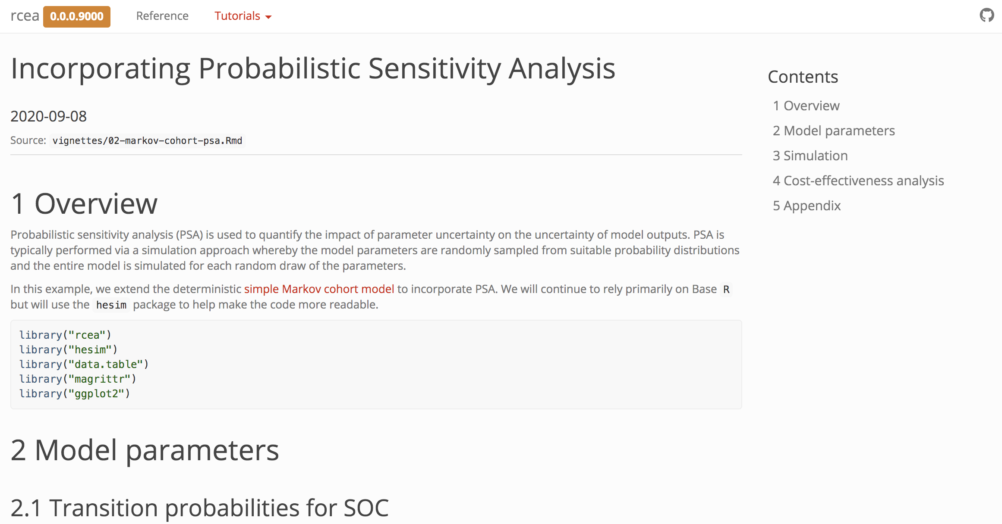
Probabilistic sensitivity analysis
https://hesim-dev.github.io/rcea/articles/02-markov-cohort-psa.html
Notes:
Present code with pkgdown documentation

Slide 69
Exercise 2: Incorporating probabilistic sensitivity analysis
Review “probabilistic-sensitivity-analysis” documentation
Modify R-script “probabilistic-sensitivity-analysis”
Reduce sample size of data for transition matrix by 50%
Increase confidence interval for relative risk
Run modified script

Slide 70
Simple Markov cohort model with hesim

Slide 71
What is hesim
hesim is a modular and computationally efficient R package for health economic simulation modeling and decision analysis that provides a general framework for integrating statistical analyses with economic evaluation.
cohort discrete time state transition models (cDTSTMs)
time-homogeneous Markov models
time-inhomogeneous Markov models
individual-level continuous time state transition models (iCTSTMs)
n-state partitioned survival models (PSMs)

Slide 72
hesim

Slide 73
Economic models with hesim
Model set-up
Parameters
Simulation
Construction of model
Simulation of outcomes
Cost-effectiveness analysis

Slide 74
Model setup
Define target population and intervention strategies
strategies <- data.frame(
strategy_id = 1:2,
strategy_name = c("SOC", "New")
)
patients <- data.frame(
patient_id = 1,
age = 25
)
hesim_dat <- hesim_data(
strategies = strategies,
patients = patients
)
print(hesim_dat)

Slide 75
Model parameters
Same list of parameters as used before
params <- list(
alpha_soc = transitions_soc,
lrr_mean = log(.8),
lrr_lower = log(.71),
lrr_upper = log(.9),
c_medical = c(H = 2000, S1 = 4000, S2 = 15000),
c_soc = 2000,
c_new = 12000,
u_mean = c(H = 1, S1 = .075, S2 = 0.5),
u_se = c(H = 0, S1 = 0.03, S2 = 0.05)
)

Slide 76
Model parameters – Random number generation
rng_def <- define_rng({
lrr_se <- (lrr_upper - lrr_lower)/(2 * qnorm(.975))
list( # Parameters to return
p_soc = dirichlet_rng(alpha_soc),
rr_new = lognormal_rng(lrr_mean, lrr_se),
c_medical = gamma_rng(mean = c_medical, sd = c_medical),
c_soc = c_soc,
c_new = c_new,
u = beta_rng(mean = u_mean, sd = u_se)
)
}, n = 1000)

Slide 77
Model parameters – Transformed parameters
Economic models in hesim consist of separate statistical models for disease progression, costs, and utility.
Each statistical model simulates outcomes as a function of input data and model parameters.
The underlying parameters (params()) are transformed (tparams()) into more relevant parameters for prediction.
E.g. define_tparams(), params_surv

Slide 78
Model parameters – Transformed parameters
Transformed parameters are modeled here as function of treatment strategies and patients, which can be generated using expand().
input_data <- hesim::expand(hesim_dat, by = c("strategies", "patients"))
head(input_data)
strategy_id patient_id strategy_name age
1: 1 1 SOC 25
2: 2 1 New 25

Slide 79
Model parameters – Transformed parameters
tparams_def <- define_tparams({
## The treatment effect (relative risk) is transformed so that it varies by
## strategies (SOC is the reference strategy)
rr <- ifelse(strategy_name == "SOC", 1, rr_new)
list(
tpmatrix = tpmatrix(
C, p_soc$h_s1 * rr, p_soc$h_s2 * rr, p_soc$h_d * rr,
p_soc$s1_h, C, p_soc$s1_s2 * rr, p_soc$s1_d * rr,
p_soc$s2_h, p_soc$s2_s1, C, p_soc$s2_d * rr,
0, 0, 0, 1
),
utility = u,
costs = list(
treatment = ifelse(strategy_name == "SOC", c_soc, c_new),
medical = c_medical
)
)
})

Slide 80
Simulation - Construct the model
Combine the underlying parameters with the expressions for random number generation and parameter transformation.
A economic model (of class CohortDtstm) can be created from a defined model (of class model_def) and data using the generic function create_CohortDtstm().
This object consists of a
transition model (trans_model) for simulating transition probabilities with sim_stateprobs()
a utility model for simulating quality-adjusted life-years with sim_qalys()
a set of cost models (for each cost category) for simulating costs with sim_costs()
mod_def <- define_model(tparams_def = tparams_def,
rng_def = rng_def,
params = params)
econmod <- create_CohortDtstm(mod_def, input_data)

Slide 81
Simulation – Simulating outcomes
Health state probabilities
QALYs
Costs
econmod$sim_stateprobs(n_cycles = 85)
econmod$sim_qalys(dr = 0.03, integrate_method = "riemann_left")
sample strategy_id patient_id grp_id state_id dr category qalys
1: 1 1 1 1 1 0.03 qalys 16.7609935
2: 1 1 1 1 2 0.03 qalys 0.1899916
3: 1 1 1 1 3 0.03 qalys 2.9997339
4: 1 2 1 1 1 0.03 qalys 19.7605951
5: 1 2 1 1 2 0.03 qalys 0.1813624
6: 1 2 1 1 3 0.03 qalys 2.4372959
econmod$sim_costs(dr = 0.03, integrate_method = "riemann_left")

Slide 82
Cost-effectiveness analysis
CEAs can be performed directly from the simulation output with hesim. Other R packages such as BCEA could also be considered.
Here, we will consider a pairwise comparison between the new treatment and SOC with the cea_pw() function.
ce_sim <- econmod$summarize()
cea_pw_out <- cea_pw(ce_sim, comparator = 1,
dr_qalys = 0.03, dr_costs = 0.03,
k = seq(0, 25000, 500))

Slide 83
Cost-effectiveness analysis
Although cea_pw() allows users to summarize output from a PSA we will just create an ICER table using means for now.
icer_tbl(cea_pw_out, colnames = strategies$strategy_name)
SOC New
Incremental QALYs "-" "2.10 (0.99, 3.24)"
Incremental costs "-" "266,741 (212,816, 295,703)"
Incremental NMB "-" "-161,900 (-222,852, -86,071)"
ICER "-" "127,212"
Conclusion "-" "Not cost-effective"

Slide 84
Steps with hesim
Model set-up
Specify the treatment strategies, target population(s), and model structure
hesim_data()
Parameters
Estimate or define the parameters of the economic model.
define_rng(), expand(), define_tparams()
Simulation
Construction of model
Create an economic model—consisting of separate statistical models for disease progression, costs, and utilities—that simulate outcomes as a function of input data (derived from Step 1) and parameters (from Step 2).
define_model(), create_CohortDtstm()
Simulation of outcomes
Simulate outcomes (disease progression, costs, and quality-adjusted life-years (QALYs)) using the model constructed in Step 3
Cost-effectiveness analysis

Slide 85
Complete R script
Link to complete R script

Slide 86
Simple Markov cohort model with hesim
https://https://hesim-dev.github.io/rcea/articles/03-markov-cohort-hesim.html

Slide 87
Exercise 3: Markov cohort model with hesim
Review and run R-script “…”
Modify R-script “…”
…
Run modified script

Slide 88
Semi-Markov multi-state model

Slide 89
Semi-Markov multi-state model

Slide 90
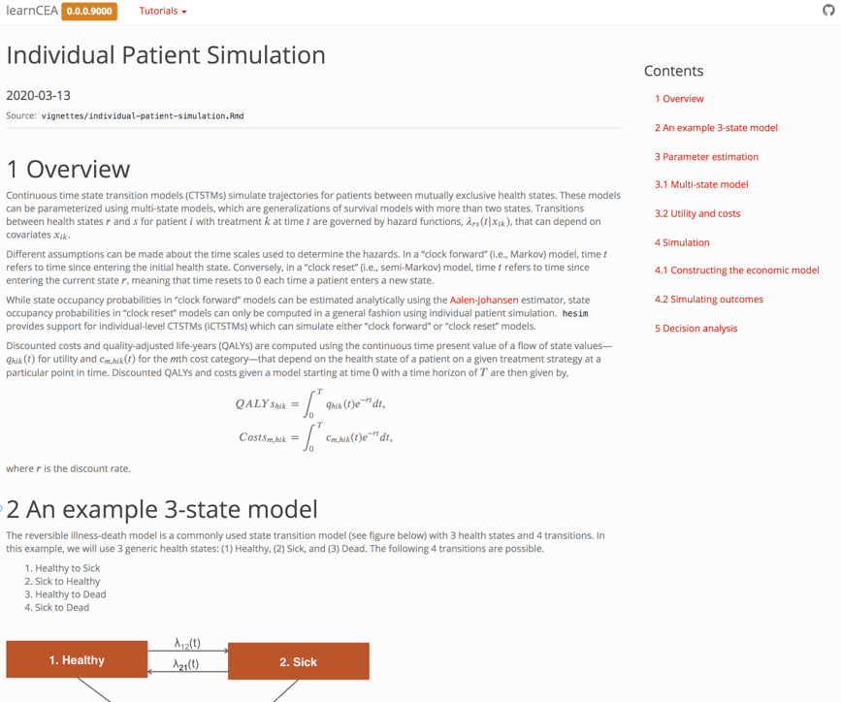
Semi-Markov multi-state model
https://hesim-dev.github.io/ispor-short-course/articles/individual-paient-simulation.html

Slide 91
Partitioned survival model

Slide 92
Partitioned survival model
An N-state partitioned survival model (PSM) simulates the probability that a patient is in each of N distinct health states at a given point of time when treated by a particular therapy.
State membership is estimated from a set of non-mutually exclusive survival curves; for an N-state model, N-1 survival curves are required.
QALYs and total costs associated with a given health state for a given treatment strategy and patient are calculated by integrating the “weighted” probability of survival, where weights are a function of the discount factor and predicted state values.

Slide 93
Demonstration: Partitioned survival model
...
…

Slide 94
Partitioned survival model
https://hesim-dev.github.io/ispor-short-course/articles/partitioned-survival-model-simple.html

Slide 95
Cost-effectiveness analysis

Slide 96
Decision analysis

Slide 97
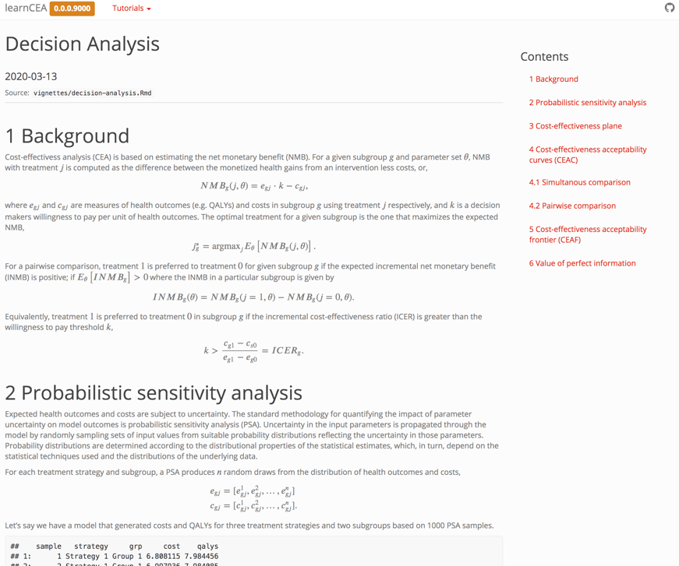
Cost-effectiveness analysis
https://hesim-dev.github.io/ispor-short-course/articles/decision-analysis.html

Slide 98
Exercise 5: Cost-effectiveness analysis
Review and run R-script “individual-patient-simulation-decision-analysis”
Explain “Decision analysis” code

Slide 99
Summary

Slide 100
So why R for CE modeling?
One platform to do everything
Your problems are rarely unique
Easier to share and review
More complex analysis and microsimulation …..

Slide 102
SLIDES THAT MAY BE USEFUL

Slide 103
Two methods for simulating multi-state models
Cohort simulation (Aalen-Johansen estimator)
Matrix version of the Kaplan-Meier estimator that can compute state occupancy probabilities
Only applicable to clock-forward models
Individual-level simulation
Simulate trajectories through multi-state model with random number generation for a large number of patients
Compute expected values by averaging over simulating patients
Applicable to both clock-forward and clock-reset models

